Slide 1
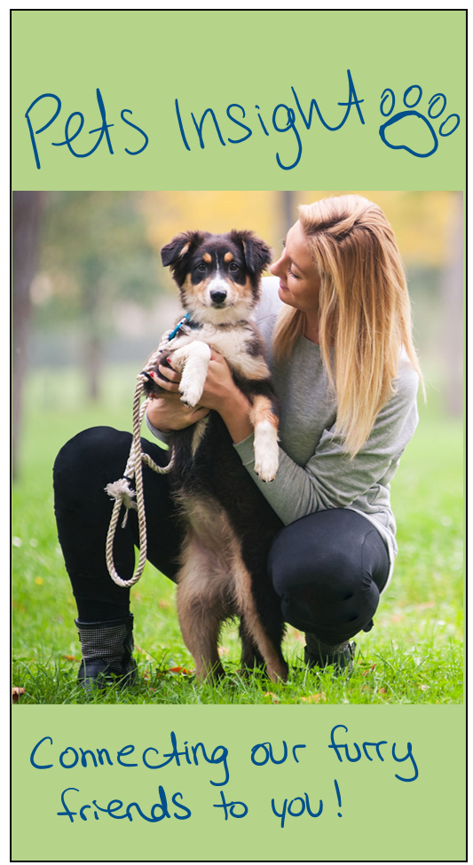
1 Welcome Page
New name
** Have Tosha draw a welcome page
** Fix Slogan

Slide 2
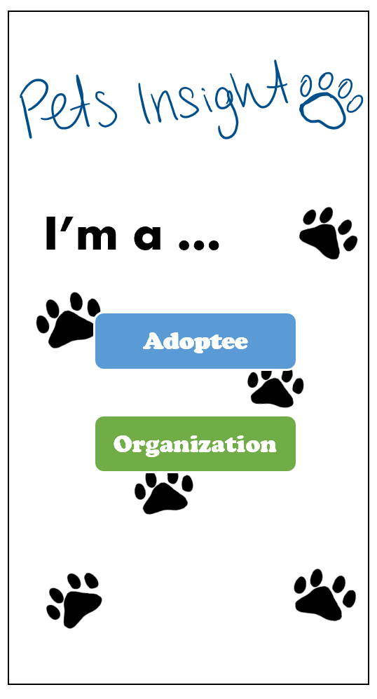
2 Account Type

Slide 3
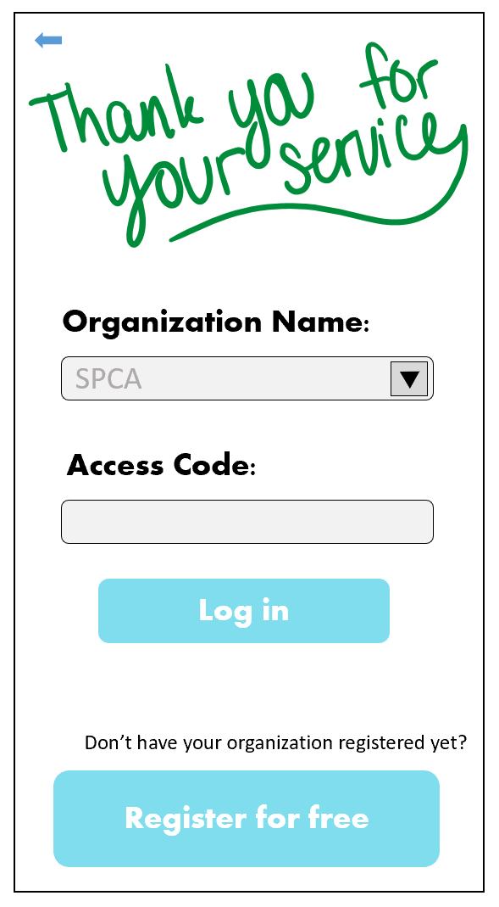
4 Organization Log In

Slide 4
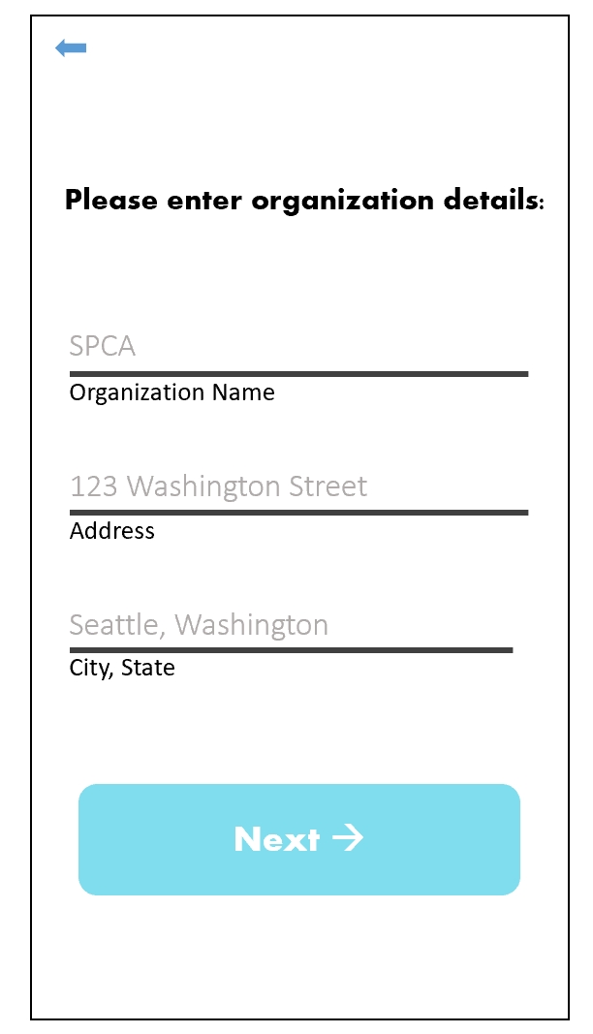
3 Organization Register (1/2)

Slide 5
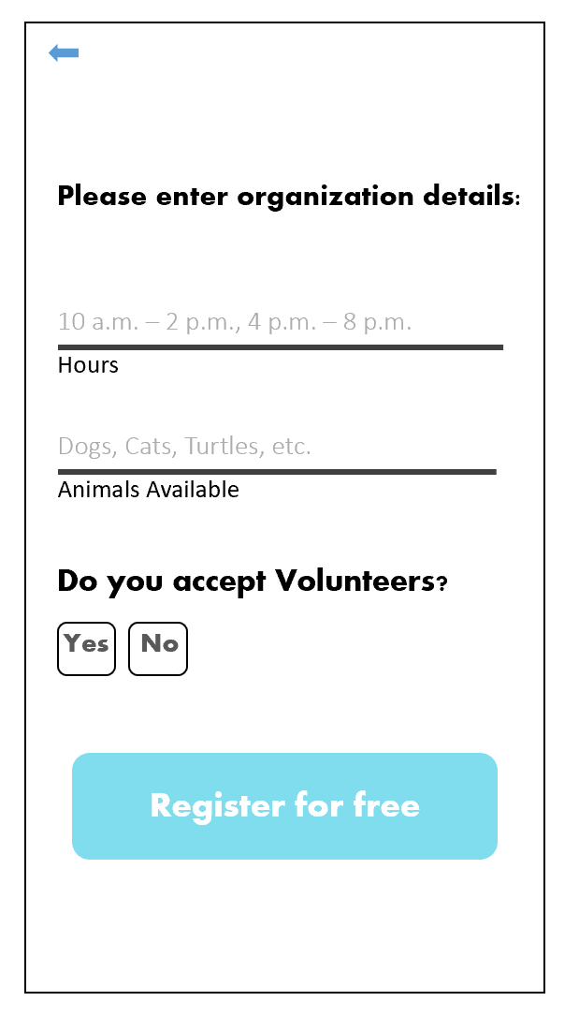
3 Organization Register (2/2)

Slide 6
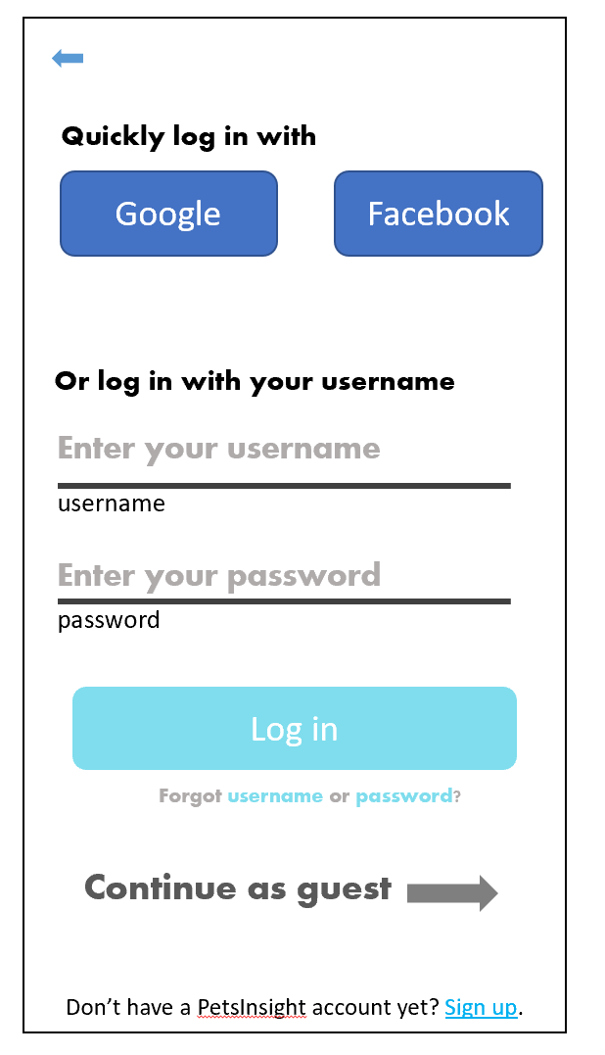
6 Adoptee Log In
Sign in with : Google, Facebook, email
Google and Facebook options will automatically create an account if they don’t already have one
Email will let them sign in via email / forgot password / or Register.
No need to show all this info at once.

Slide 7
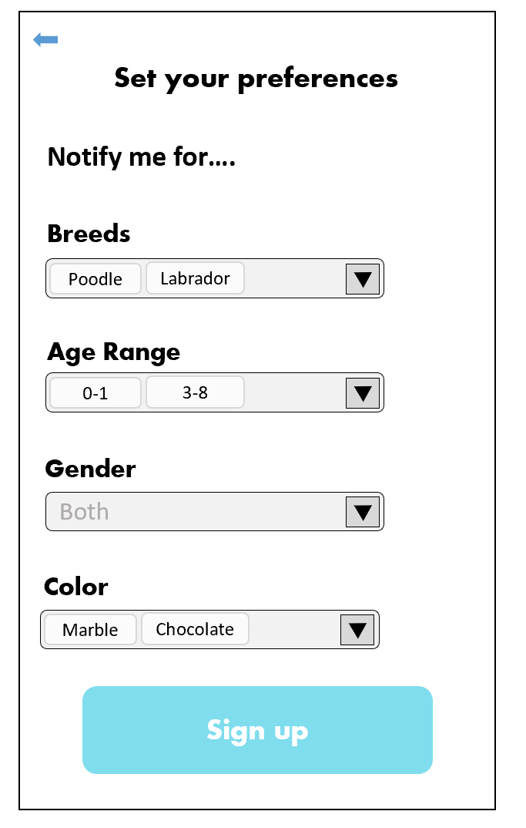
5 Adoptee Set up Page
Concept
Register preferences
** make these drop down lists!!
But offer multiple selections
Get notified when preferences are found
Inform them that they can add pets to their “favorites”, and will get notified when someone adds pics/info on that pet
** also have to limit breeds before for Cats/Dogs/Others
* For Others, don’t have breeds as a drop down + same with color (bc that’s too specific)

Slide 8
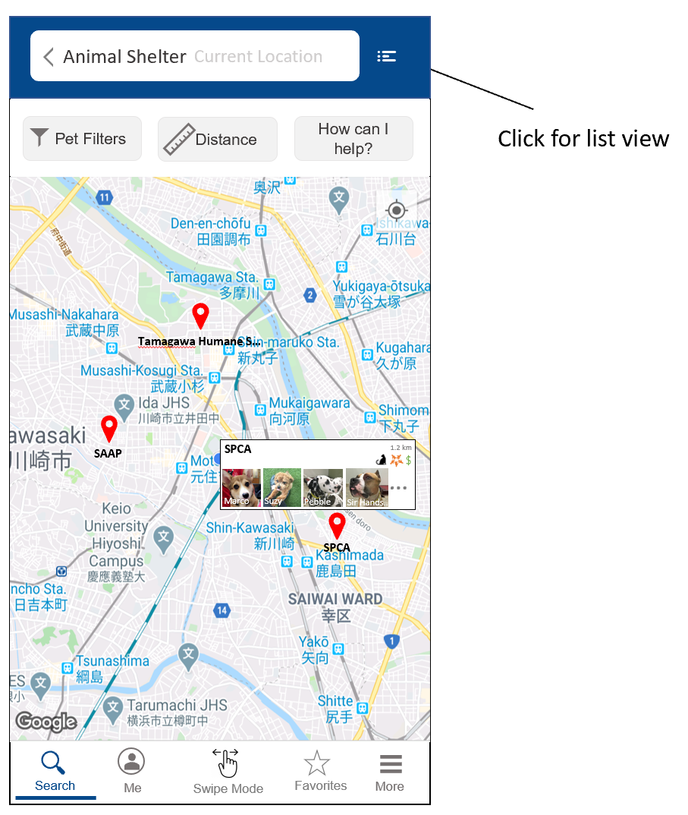
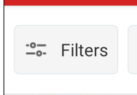
7.1 User Main Screen
NEEDED:
Pet Filters Icon (look at yelp)
Distance Icon
Swipe Mode Icon
I want swipe mode to stick out from the rest;
Maybe a bolder color? Different color altogether?
Favorites Icon
Better shorthand for “How can I help?”
Icon for Pins (optional)
Icon for cat by itself, dog by itself, “exotic” by itself,
And then cat + dog, cat + exotic, dog + exotic, and all three together (total of 7)
Icon to represent that volunteers are wanted
Icon to represent that donations are needed

Slide 9
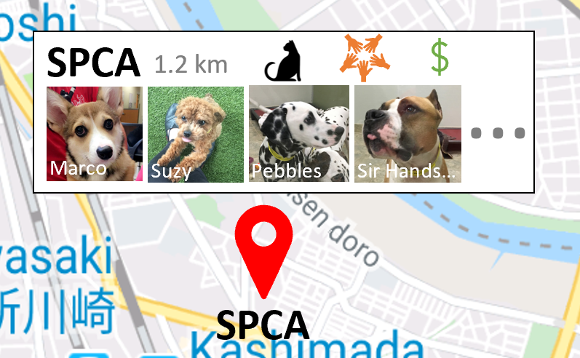
Location Info Tile
If you wish to play around with this layout,
Please feel free!!
Info I want to be represented here:
Name (sometimes long like:
Animal Friends Humane Society of Hamilton
so…. :/
Distance
What animals are available (best shown thru icon?)
If volunteers are accepted (grayed out or not shown otherwise)
If they need donations (grayed out or not shown otherwise)
An initial subset of available pets ☺

Slide 10
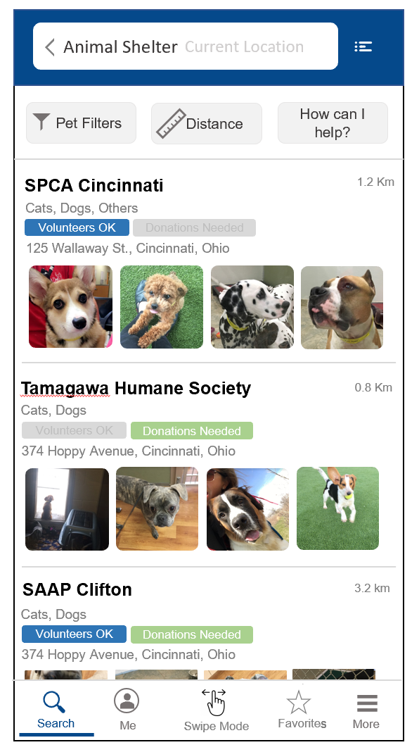
7.2 List View

Slide 11
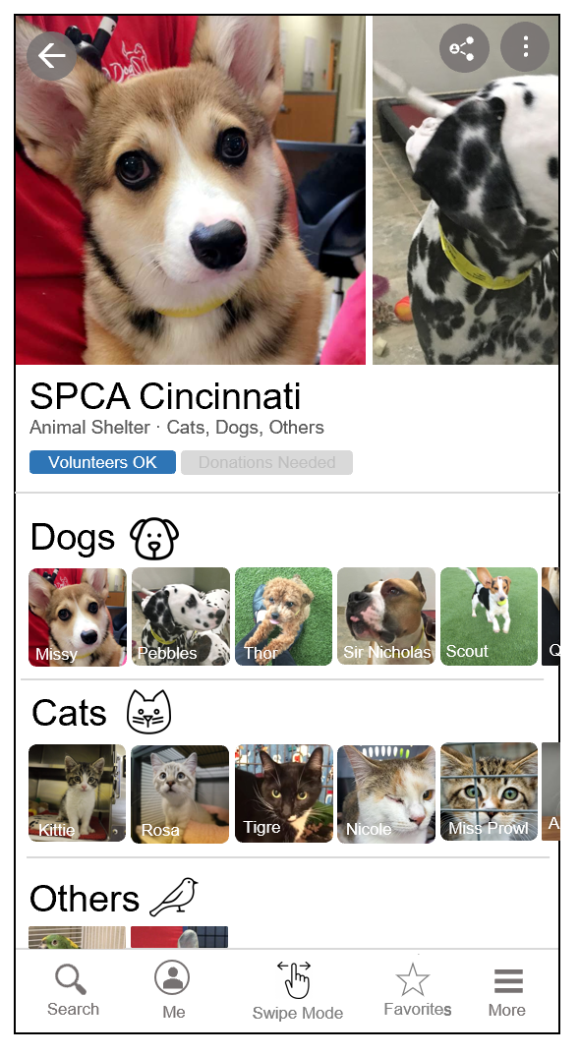
9 Specific Tile
Need:
Dog Icon
Cat Icon
“Other” Icon
Can be the same as before?
Q
A

Slide 12
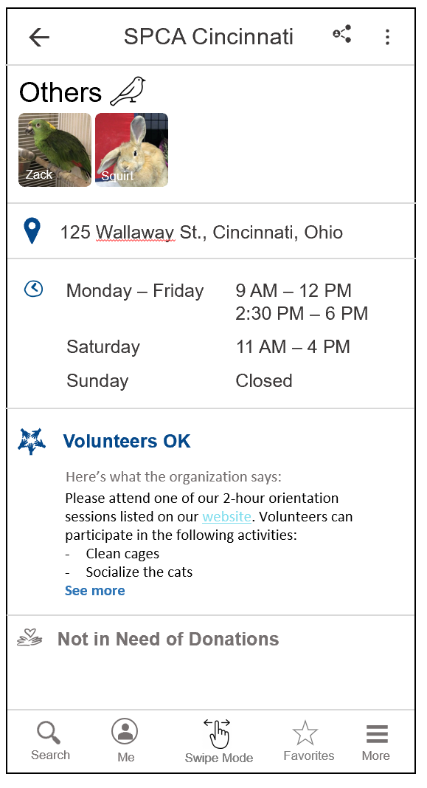
9 Specific Tile
Something for Donations
** bubble format of the items they’ve requested (custom)

Slide 13
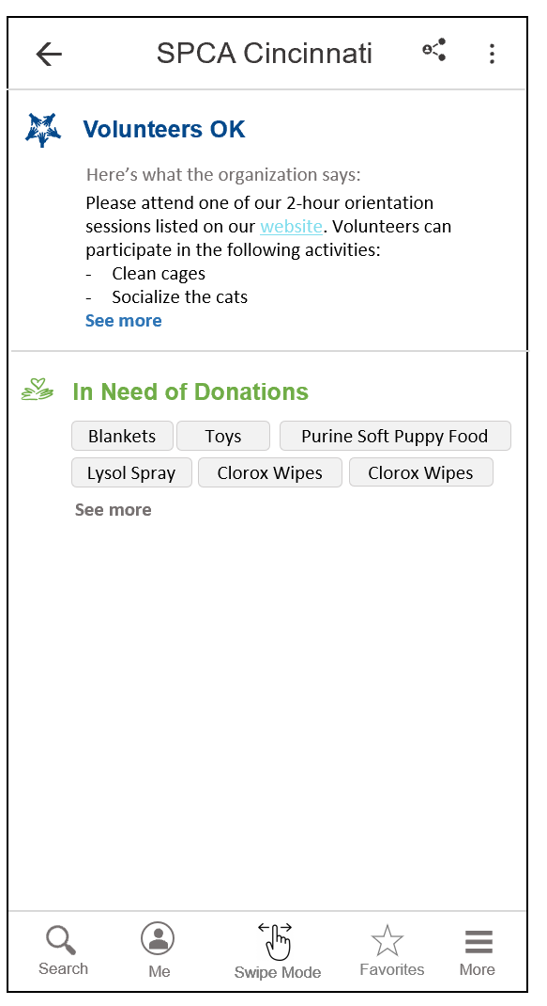
9.1 Example of Donations Needed box

Slide 14
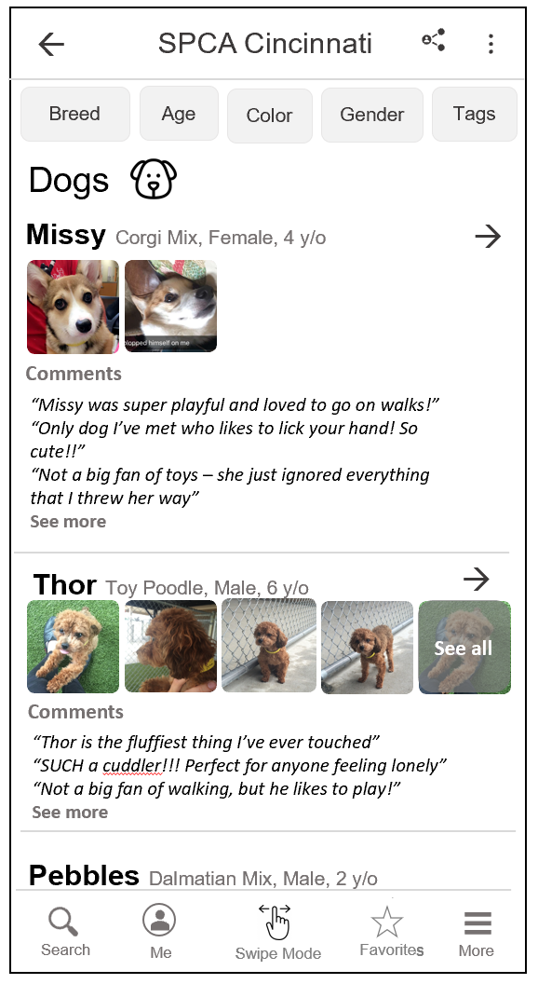
What happens if they click Dogs/Cats/Other

Slide 15
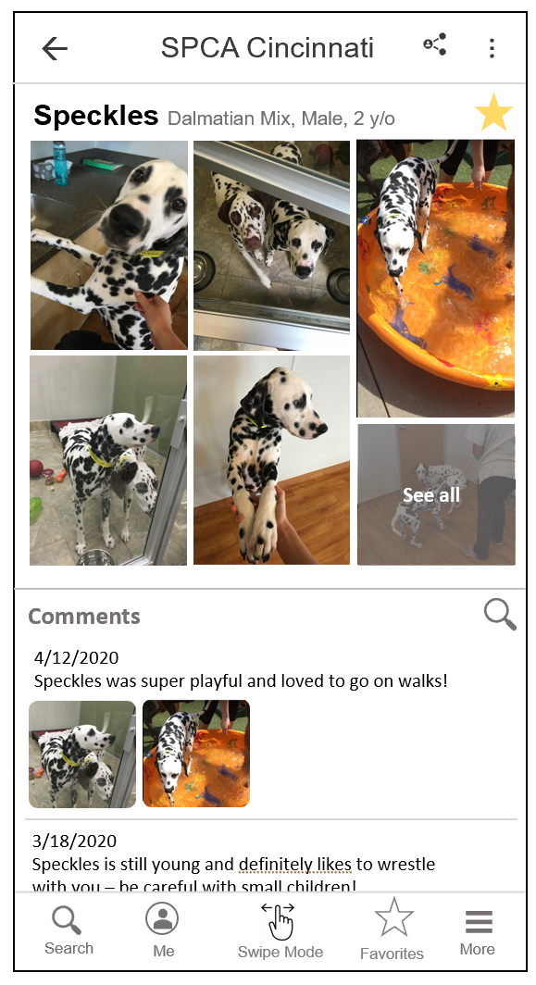
What happens if they click on a specific dog
Clicking on “SPCA Cincinnati” brings them back to their home page
They can tap on the star to add the dog to favorites
Just have them keep scrolling to see all the comments, allow a filter for keywords (one at a time)
Need to add somewhere for user to add image or comment !!!!!

Slide 16
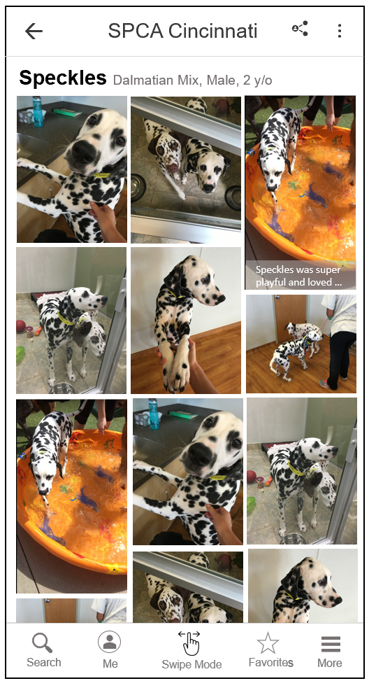
What happens if they click “see all” for the images
Clicking on “SPCA Cincinnati” brings them back to their home page
Just have them keep scrolling to see all the comments, allow a filter for keywords

